Slide 1
Internship Report
Yexi Jiang

Slide 2
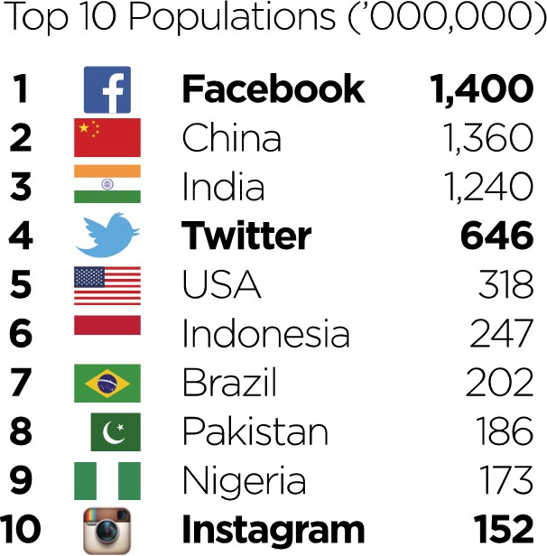
What is Facebook Inc.?
The world’s largest social network.

Slide 3
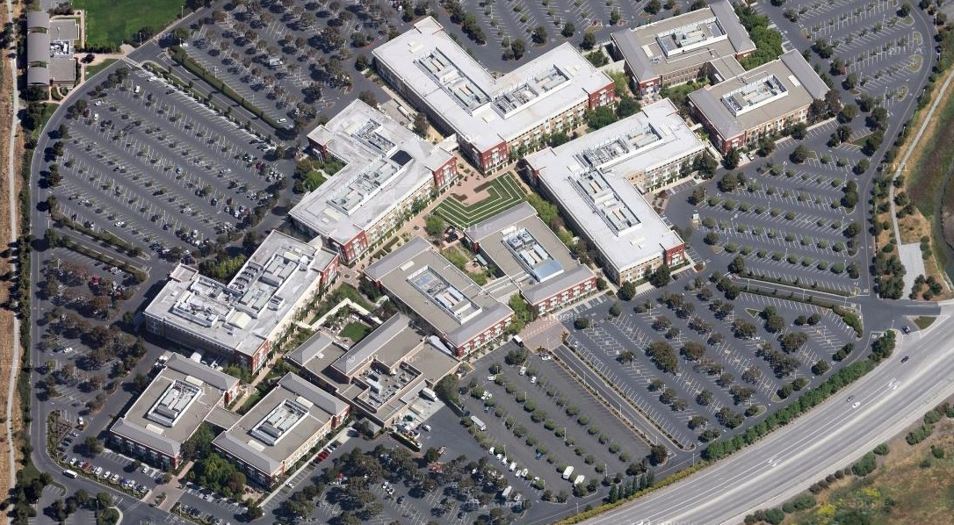
The campus

Slide 4
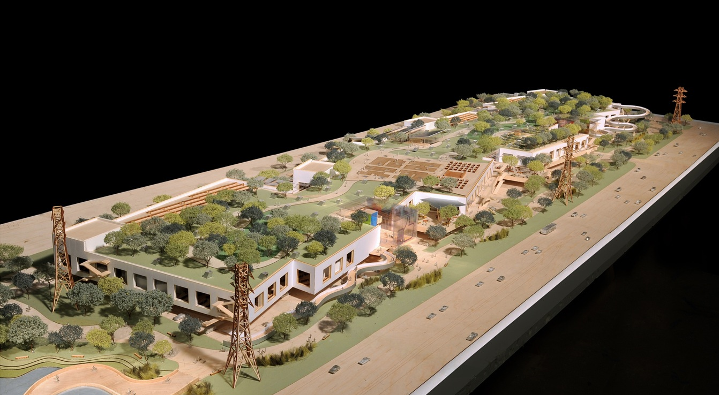
The new one

Slide 5





What are their products?

Slide 6
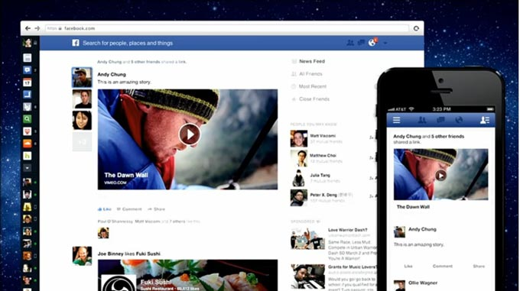
What I do there?

Slide 7

Personalized news feed ranking
Existing solution: A single model for all the users.
Hundreds of Factors
Create time of post, Length of post, Whether you liked the post of the same creator within 1 week, Number of likes of the post, Number of comments of the post, Number of shares of the post, Number of followers of the creator, etc…
Data Bucketing
Train Gradient Boosting Tree
Training Instance
Feature vector

Slide 8
Limitation of Current Solution
Cannot make good use of the ID-feature.
E.g. whether this post is created by Ian, or shared by Ian, or Ian is mentioned?
Cannot make good use of the personal feature.
E.g. whether the viewer liked the post in topic basketball?
No use of the post content features.
E.g. whether the content is related to basketball, football, or video games?

Slide 9

Solution High Level Overview
Offline Part
Raw Data
Filter By User
Join with Extra Features
Data Preprocess
Model DB
Train Personal LR Model
Feature Construction
Train Personal Gradient Boosting Tree
Online Part
Retrieve personal model
Retrieve data
Ranking (complex)
Return ranked posts

Slide 10
Some stats
Offline Evaluation: More active the user is, more gain can be achieved. (AUC)
Online Evaluation:
0.1% user (1.4 million user)
1-2% increase of user engagement (like, comment)

Slide 11
Future Work
Integrate the work of news feed ranking team and public content team
Join feed features with text features
Increase performance

Slide 12
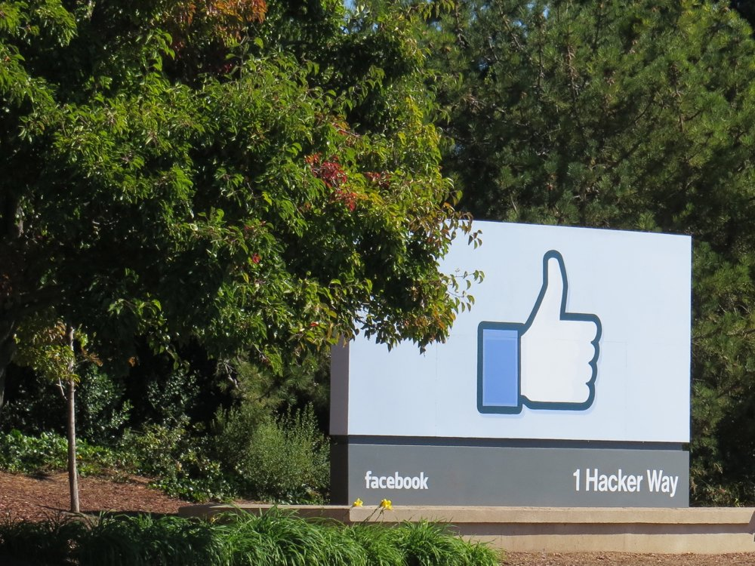

Slide 13
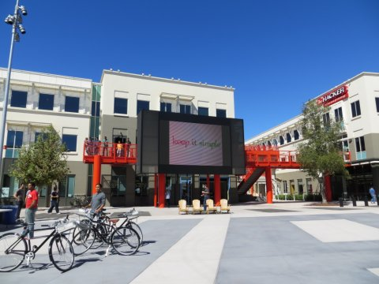

Slide 14
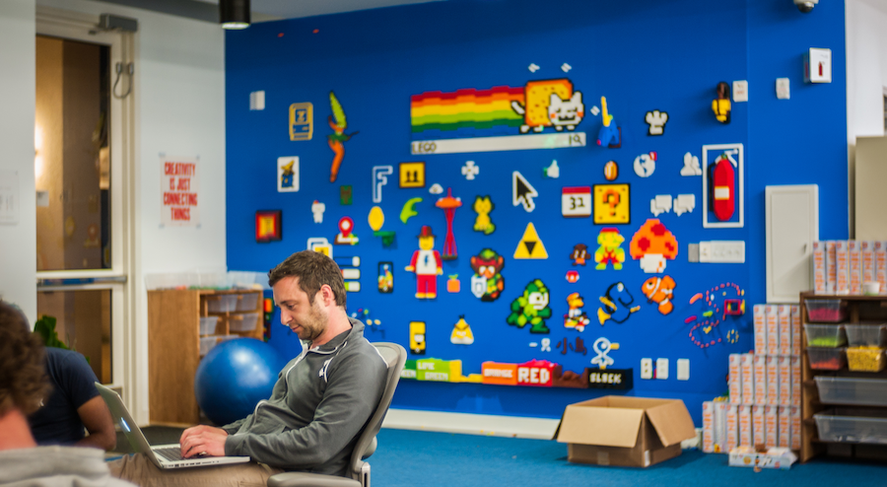
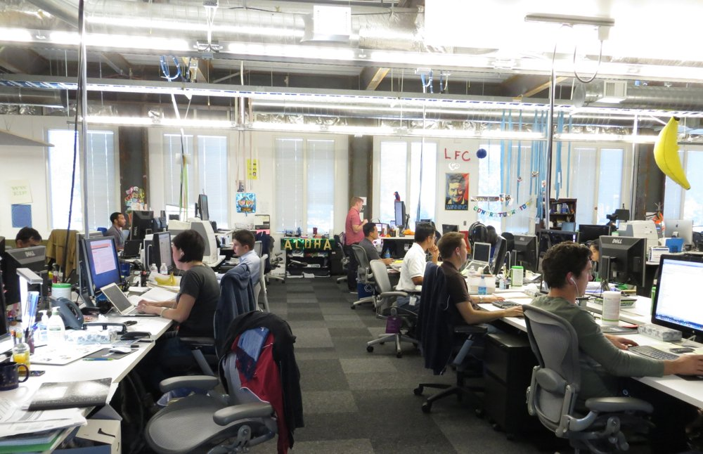
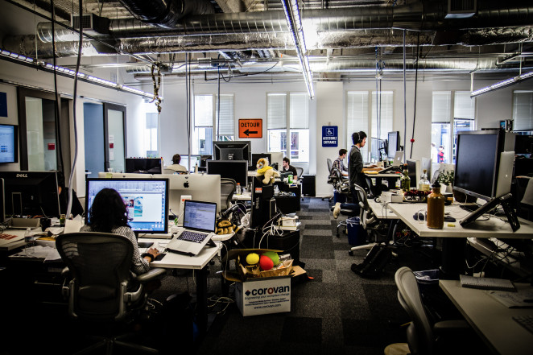

Slide 15
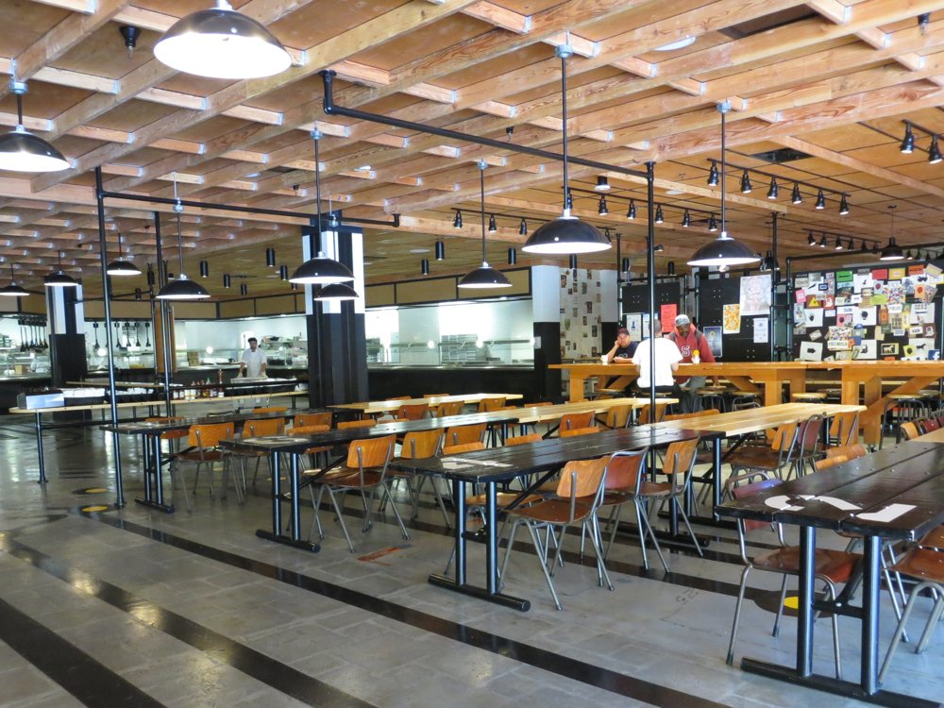
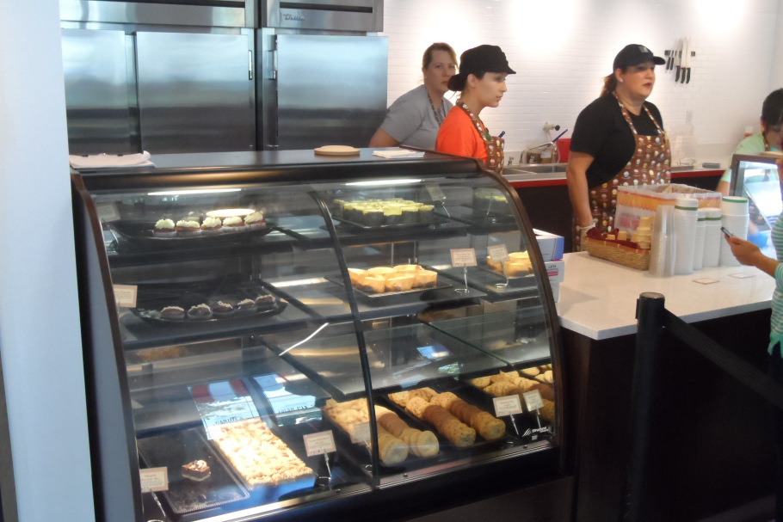
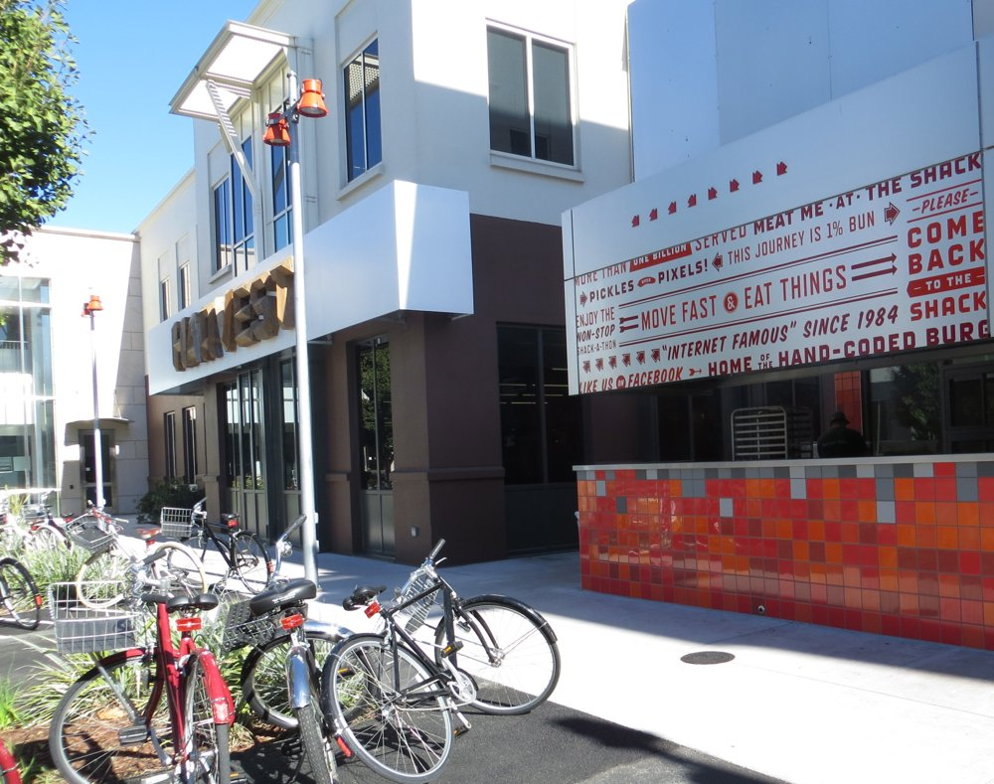

Slide 16
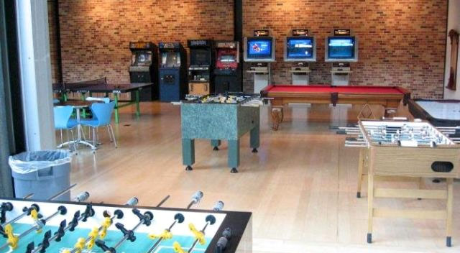
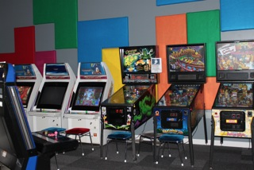
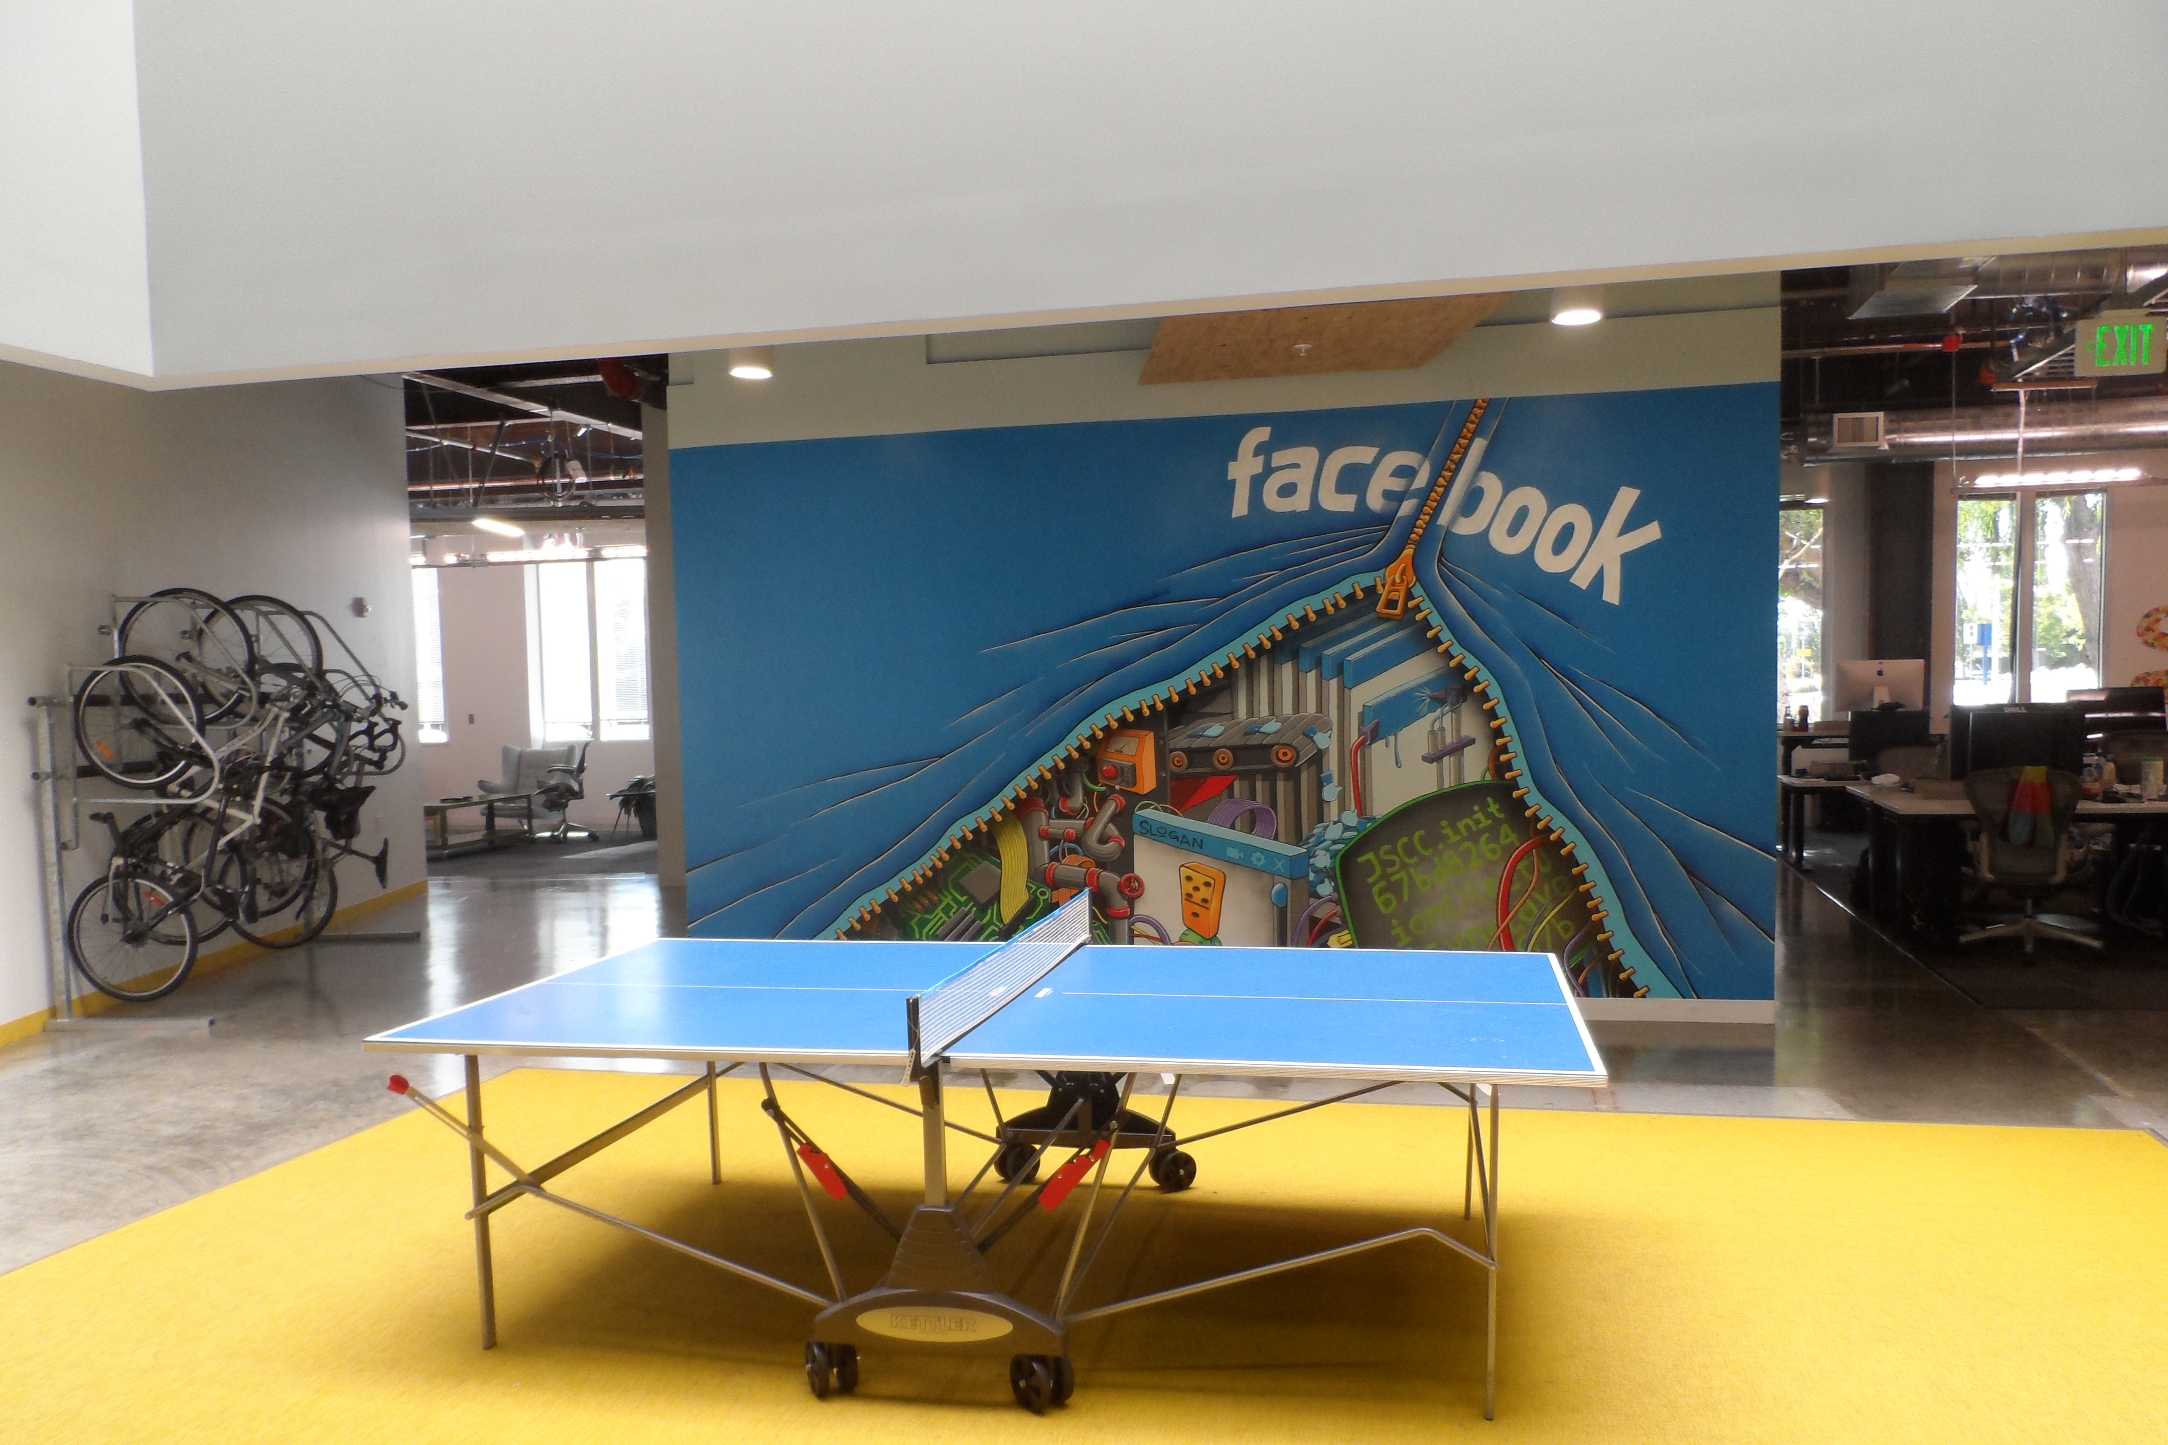

Slide 17
